Slide 1
7 Minutes Workout
Android Application

Slide 2
Presented by:
SHRI VITHAL EDUCATION and RESEARCH INSTITUTES’s, COLLEGE OF ENGINEERING, PANDHARPUR
Mr. RAHUL K. DEVKATE (PRN: 2019032500209617)
Mr. UMESH V. MADANE (PRN: 2019032500208614)
Mr. SWAPNIL B. MORE (PRN: 2019032500208711)
Mr. SHUBHAM G. SHENDE (PRN: 2019032500208185)
Mr. DNYANESHWAR S. LOHAR (PRN: 2019032500208564)
Project guide: Mr. Shrikant Salotagi

Slide 3
Presenting to you
Introduction
Literature survey
System Analysis and Design
Development tools
Results
Conclusion/future scope

Slide 4
introduction
We often see around that people are not taking care of their health. Once health is as important as any materialistic thing around them. As I am an computer Engineer, I personally experienced the need of health-related app to be once crucial guides in day-to-day life. The goal of health apps is to make the experience of healthcare more efficient and satisfying for all stakeholders involved. Health apps are ultimately judged by their value to the healthcare system; their ability to improve the patient experience and patient outcomes as well as reduce the costs of care.
PROPOSED WORK:
So we created 7-minute workout app provide some exercise to users
User can test himself/herself on BMI index
User can see the history of his/her workout

Slide 5
LITERATURE SURVEY
There are many different android applications in market which helped in our projects and gave lots of new ideas. We studied some benefits of exercises based on that we have selected some exercises which can be exercised daily by all age group to stay fit.
Currently most popular apps are discussed as follows:
1. MyFitnessPal
MyFitnessPal is a smartphone app and website that tracks diet and exercise. It offers auto-renewing systems, according to Apple. The app uses gamification elements to encourage adherence to exercise and diet goals.
2. Headspace
Headspace is a mindfulness app with an easy-to-use interface that takes the seriousness and intimidation out of meditation. According to TechCrunch, Headspace is one of the most frequently downloaded mindfulness apps in the world,

Slide 6
3. Fit plan
Fitplan is a mobile application that provides on-demand video workout sessions. Consumers can sign up for a subscription (monthly or annual) or utilize their library of free single day workouts. All the workouts are formulated by dozens of fitness coaches.
The Importance of Exercise
Community centers, local YMCAs, health clubs, and other organizations offer age-appropriate exercise programs for children and adolescents led by experienced and knowledgeable instructors. In addition, home exercise videos geared toward children are available in stores and from Web sites.
For children and adolescents with medical conditions that may limit exercise or place them at higher risk for exercise-related complications, supervised exercise programs may be available at hospital-based wellness centers. We all know that exercise is important in our daily lives, but we may not know why or what exercise can do for us.

Slide 7
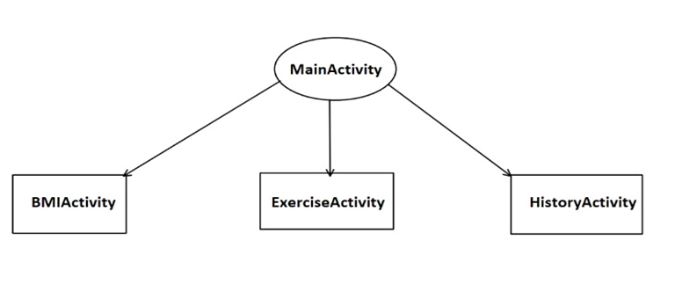
Proposed system
We came up with the solution ,that is an android application (7-minute workout app) which is inspired by above survey. Our application is very user friendly. As android apps are highly in use in mobiles, we thought doing this project in android would create impact on society. Why a Mobile Application? A Mobile Application is a set of software which is designed and developed in such a way that it can run on any mobile device, smart phone or tablet.
UI interface

Slide 8
Proposed system
Application available in play store, exercise have only names and their description, but in our application, we have name as well as tutorial of each exercise that’s why it is easier to do exercise for beginners.
Application UI is simple and user friendly.
In our application, we have notification sound that will notify you that time for your previous exercise is finished, now it is time to do next exercise.
In our application we have history option i.e., you can check that how many times you do the workout and check your daily, weekly or monthly progress.
In our application we have a BMI calculator also so that you can also calculate your Body Mass Index to check how many weights you have to loss or gain for healthy body.
User can do exercise in within less than 10 minutes.

Slide 9
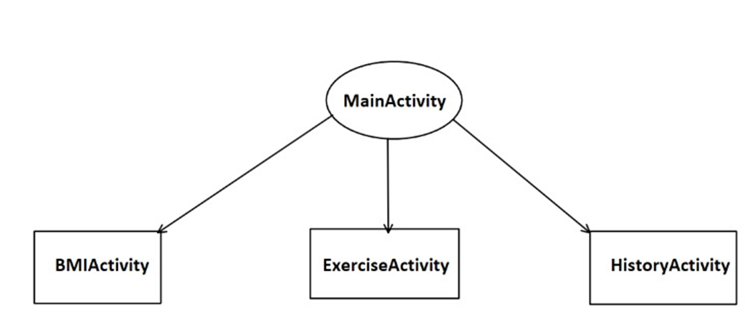
SYSTEM ANALYSIS AND DESIGN
System analysis is the process of gathering and interpreting facts, diagnosing problems and using the information to recommend improvements on the system. System analysis is a problem-solving activity that requires intensive communication between the system users and system developers.
UI interface

Slide 10
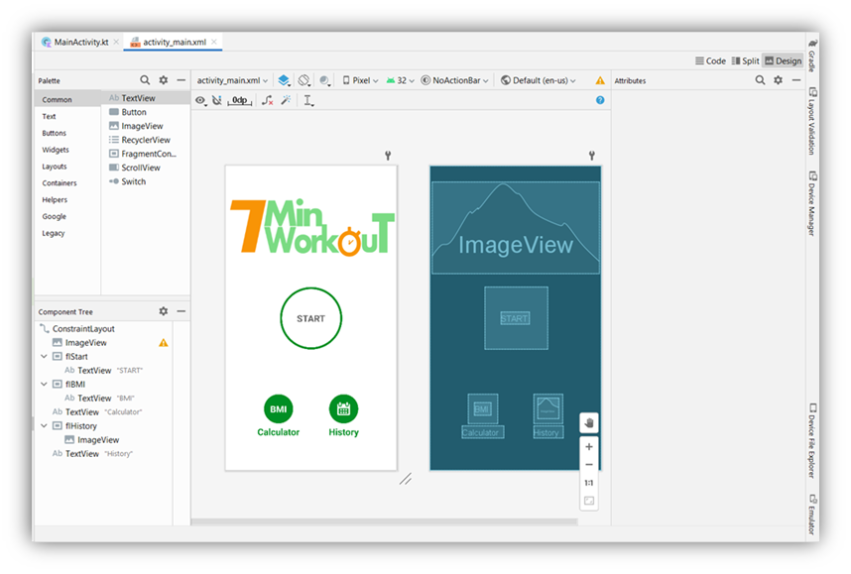
Main Activity
The main activity code is a Kotlin file MainActivity. This is the actual application file which ultimately gets converted to an executable and runs your application.

Slide 11
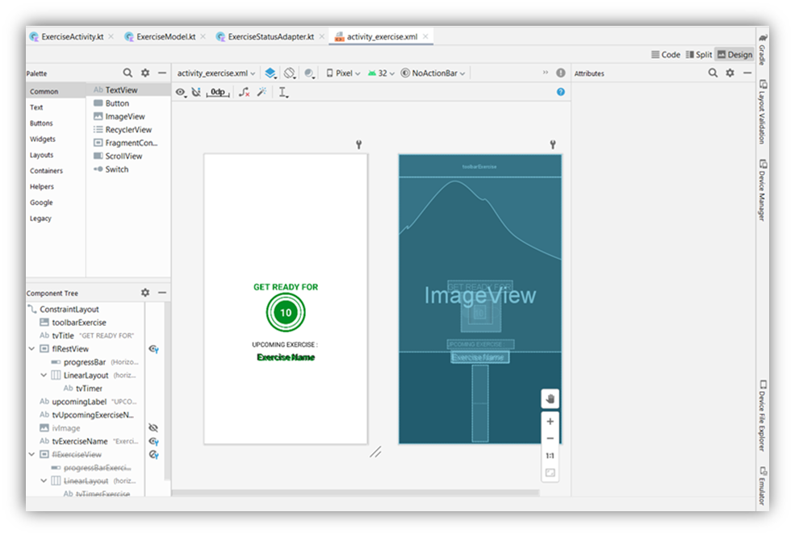
Exercise Activity
ExerciseActivity contains all the major code which drives this activity.

Slide 12
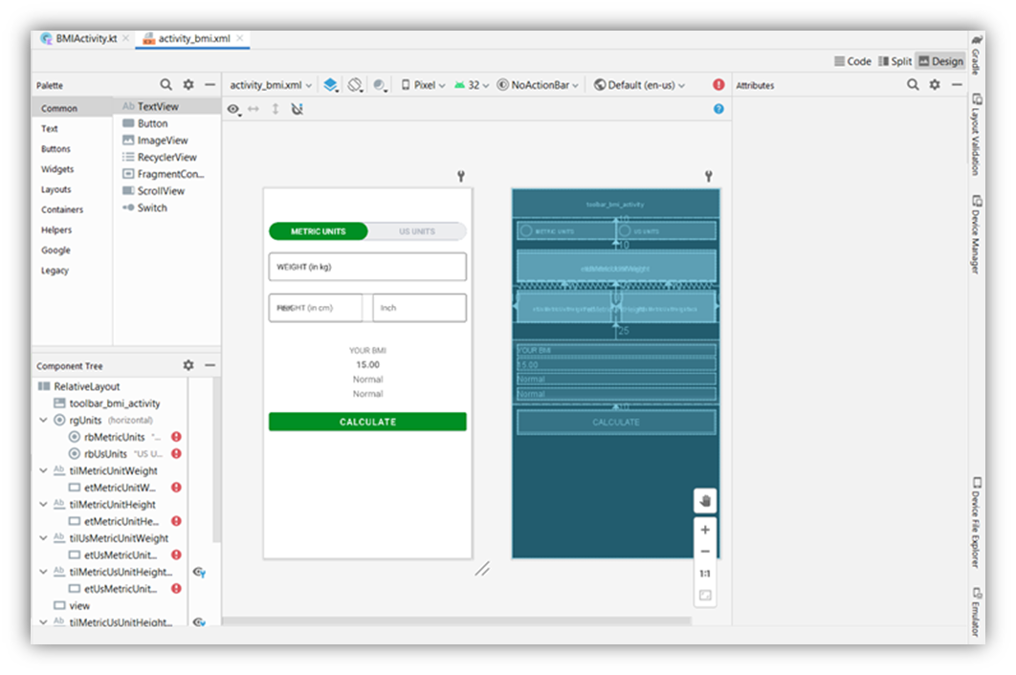
BMI Activity
BMIActivity, it allows us to switch between the tabs as per the user requirement. One tab the BMI is calculated using the input provided by the user in SI units i.e., weight in Kg and height in cm which is converted to the meters at the time of using formula and another tab input height in feet inches. BMI here are calculated as per the US system.

Slide 13
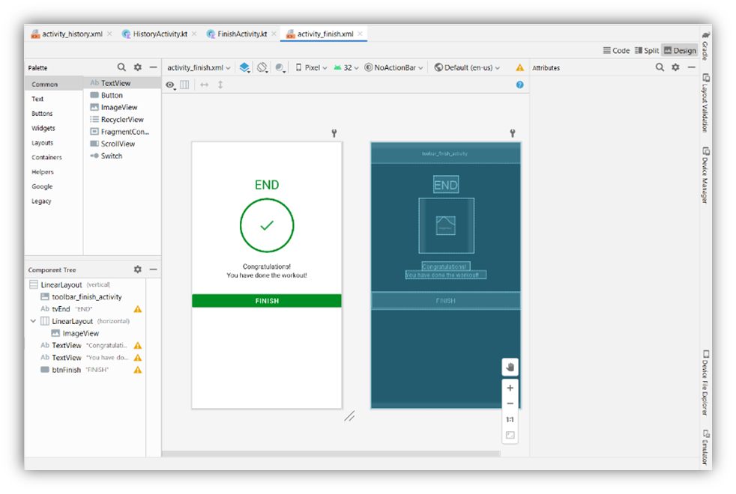
Finish Activity
FinishActivity is the last activity after exercise. FinishActivity, we have a Function is used to insert the current system date in the SQLite database. We have taken an instance of Date Formatter as it will format our selected date in the format which we pass it as a parameter and Locale.

Slide 14
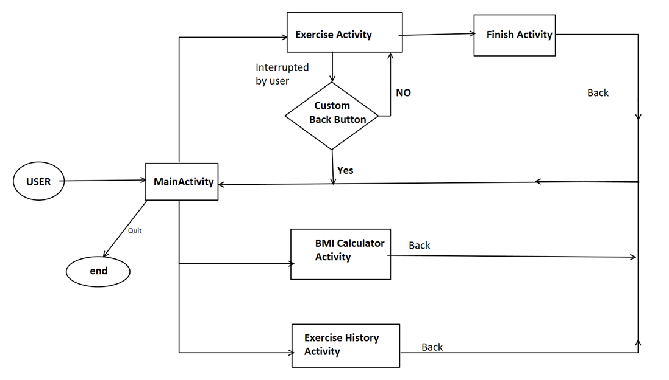
Project structure
Flow of whole application

Slide 15
Development tools
Android Studio
The development of Android applications is done using the Android Software Development Kit (SDK). This SDK comes with all the necessary development tools needed, including all the relevant libraries, a debugger and an Android emulator. The main platforms which are currently supported for development or Android are any modern desktop Linux distribution, Windows XP or later, and Mac OS X 10.5.8 or later.

Slide 16
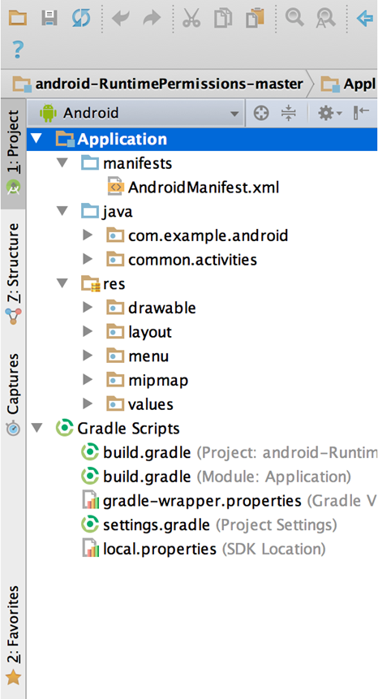
Gradle Build
Gradle Scripts are the recent feature that is added to Android Studio. It is basically an automated build system which is used to automate the various phases involved in designing an application that includes design, development, test, debug, and publish.
All the build files are visible at the top level under Gradle Scripts and each app module contains the following folders:
manifests: Contains the AndroidManifest.xml file.
java: Contains the Java source code files, including JUnit test code.
res: Contains all non-code resources, such as XML layouts, UI strings, and bitmap images.

Slide 17
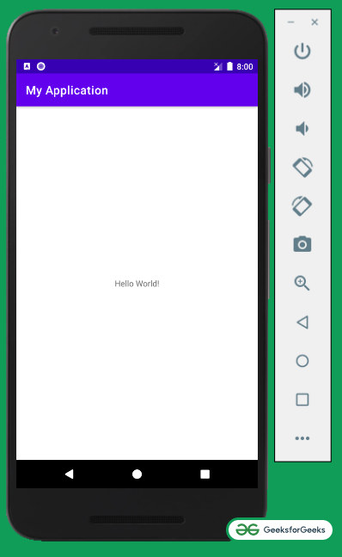
Android virtual Device
It is used to create virtual devices of any desired API level to support higher level SDK’s in case our device does not support. Using emulators to test the application is difficult as it might be little slower when compared to real device.
SQLite Database
Android also supports inbuilt database which is Android SQLite to develop any small applications and perform any CRUD (Create, Update, and Delete) operations. As it is not flexible enough to support substantial number of data, for complex applications we are using other external databases.

Slide 18
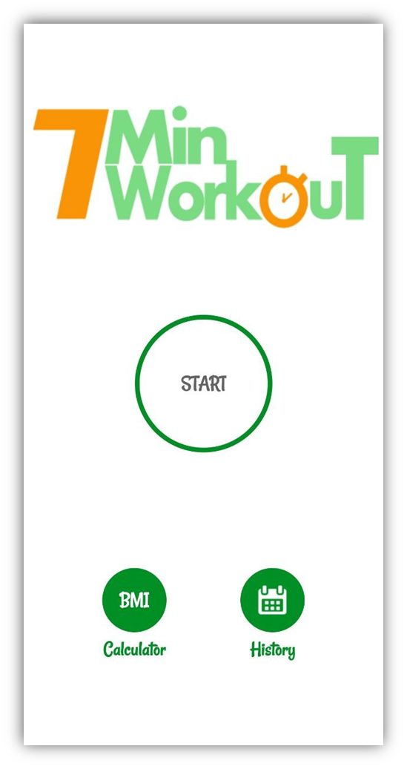
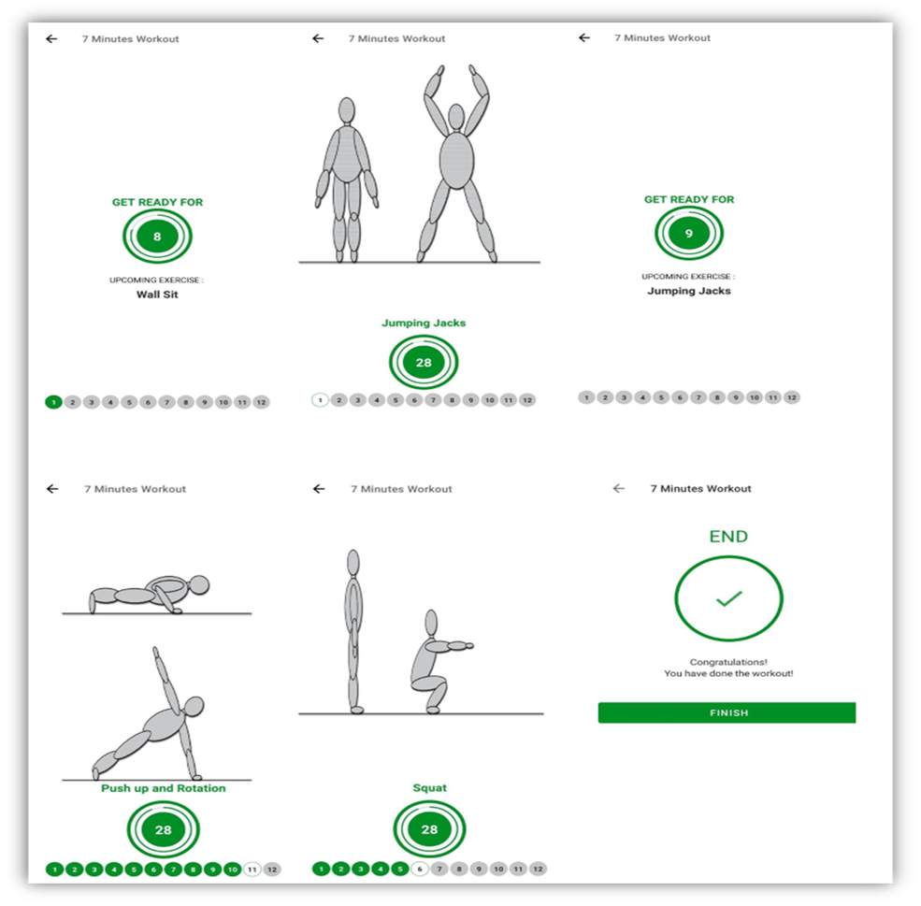
Results
Main interface
Exercises / finish interface

Slide 19

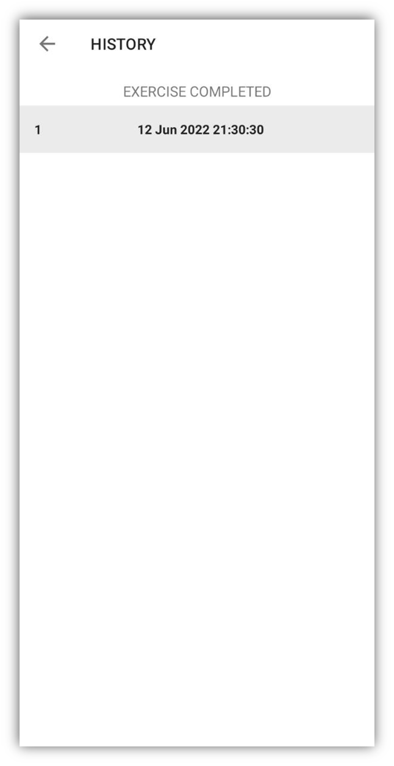
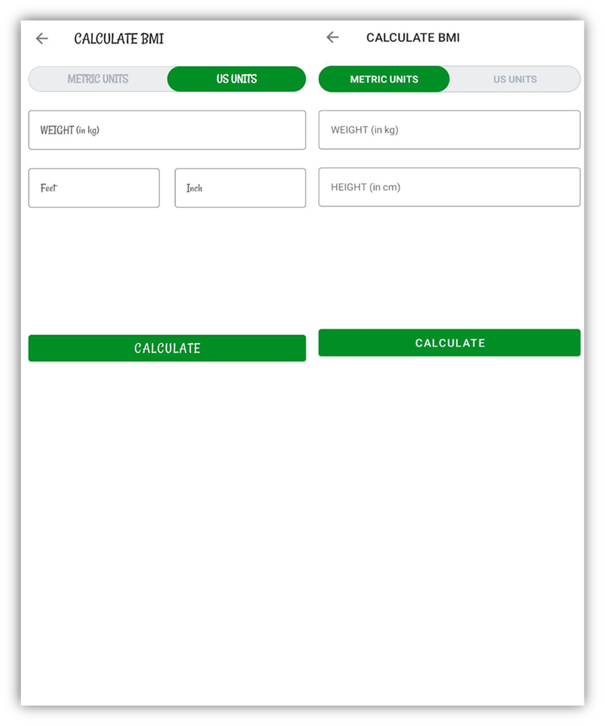
History
BMI calculator

Slide 20
CONCLUSIONS
The project titled 7-minute workout app is an android-based application that enables the user to keep an eye on their fitness regime. The project has been completed successfully with maximum satisfaction. The constraints are met and overcome successfully. The system is designed like it was decided in the design phase. The project gives a good idea on developing a user-friendly application satisfying the user. The system is very flexible and versatile. This application has a user-friendly screen that enables the user to use it without any inconvenience.
This project is more informative and more helpful for understanding the concept of android app development. This project is only a small and easy one but it is enough to implement my concept. we can further try much harder to make a much more efficient and useful app that can benefit others

Slide 21
Future scope
As we are in learning phase, we tend to add less features as time progresses, we learn android, and other important skills then We are definitely going to work on this project and add some more features.
Features to be added are as follows:
1.Send alert message to the users.
2.add some gym music and meditative feature
3.add some diet plan according to user BMI and meal time
4.use some features of fitness watches

Slide 22

Thank You

